Slide 1
Customer Retention
Submitted by:
Akhand pratap singh

Slide 2
Introduction
Customer satisfaction has emerged as one of the most important factors that guarantee the success of online store it has been posited as a key stimulant of purchase, repurchase intentions and customer loyalty.
A comprehensive review of the literature, theories and models have been carried out to propose the models for customer activation and customer retention.
Five major factors that contributed to the success of an e-commerce store have been identified as: service quality, system quality, information quality, trust and net benefit.

Slide 3
Problem statement
The combination of both utilitarian value and hedonistic values are needed to affect the repeat purchase intention (loyalty) positively .
The objective was to perform extensive data analysis on a given dataset and produce valuable insights that will help in customer retention.
The dataset consist of 71 features and 269 rows

Slide 4
Exploratory Data Analysis
Checking shape of data.
Checking data types of each features using dataframe.info() function.
checking for null values in each column.
Checking description of each categorical feature by using dataFrame.describe(include='object').T
Displaying each categorical attribute values in terms of percentage.
Count plot to see the counts of each attribute.
Bivariate analysis by adding hue parameter to seaborn plot and keeping ‘x’ parameter as ‘purchase frequency of customer’.

Slide 5
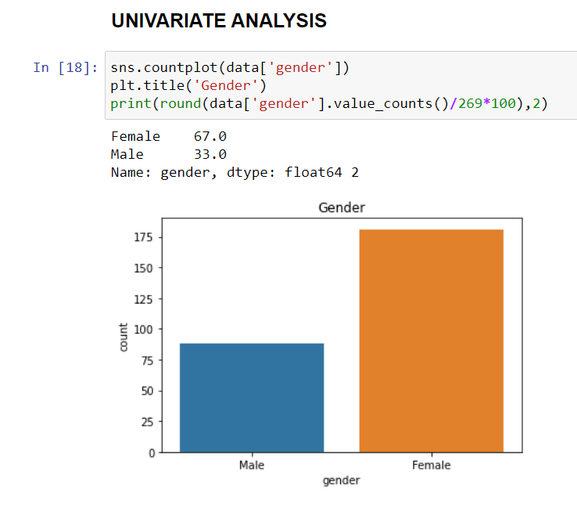
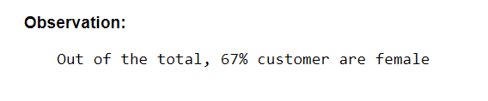
Visualization

Slide 6
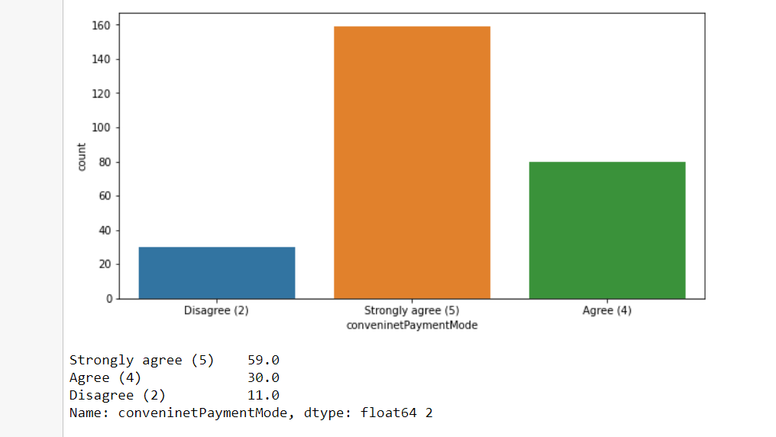
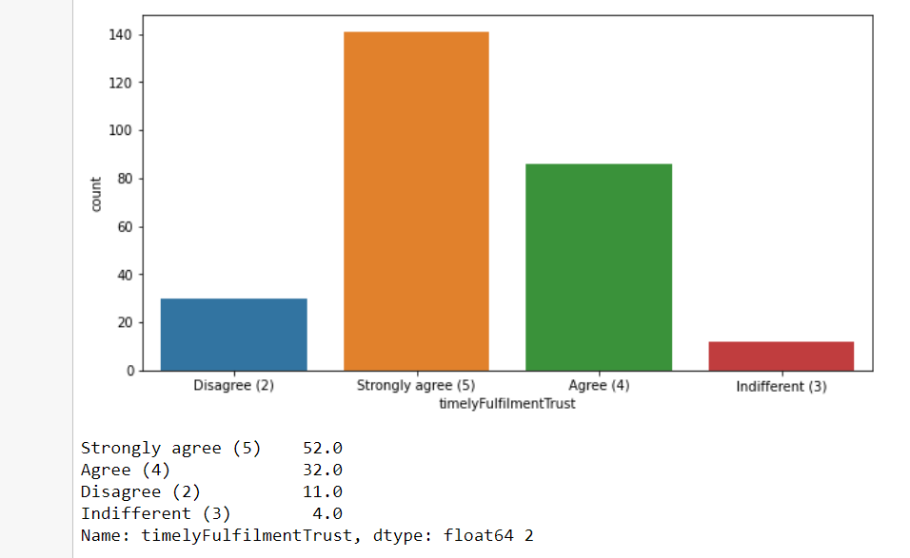

Slide 7
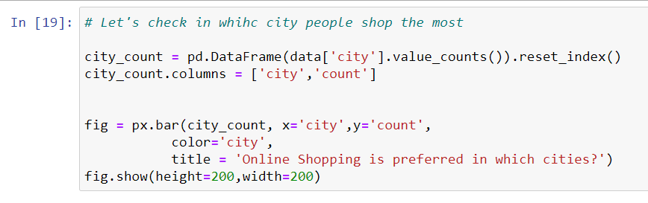
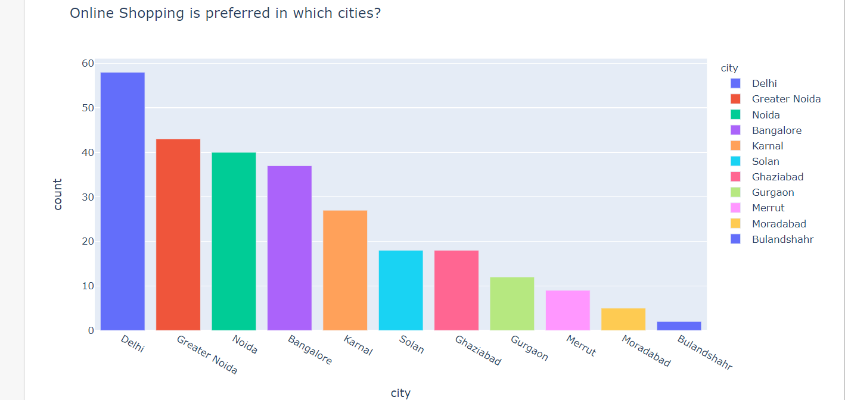
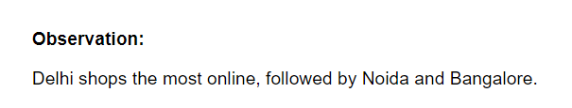

Slide 8
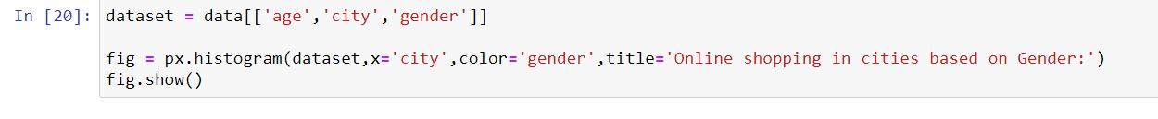
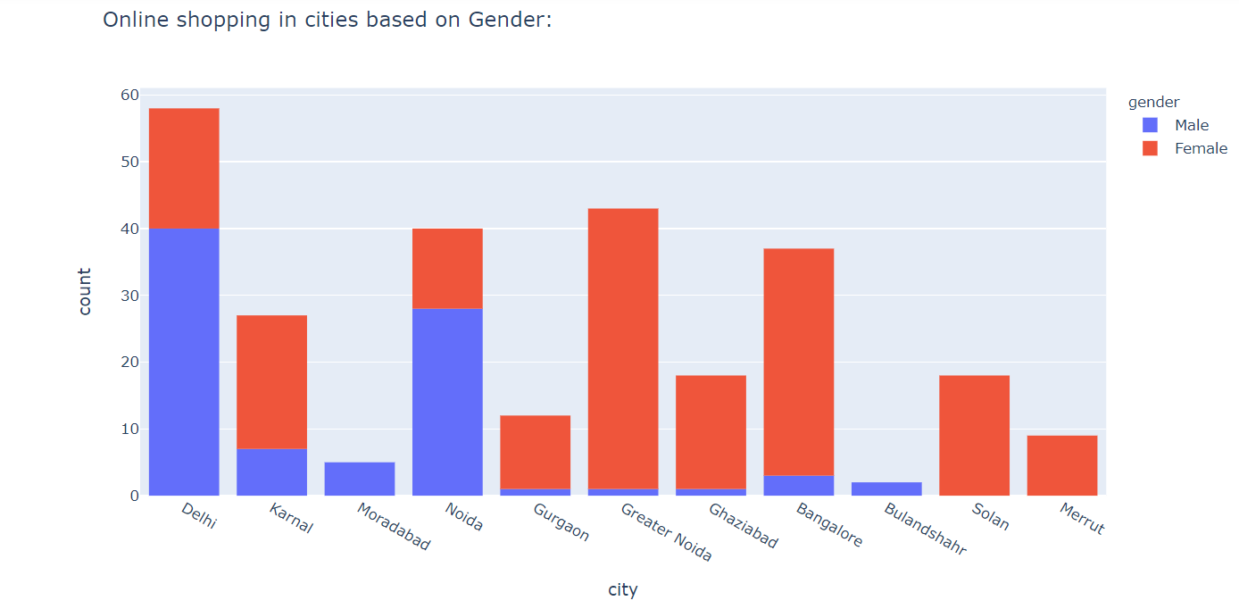
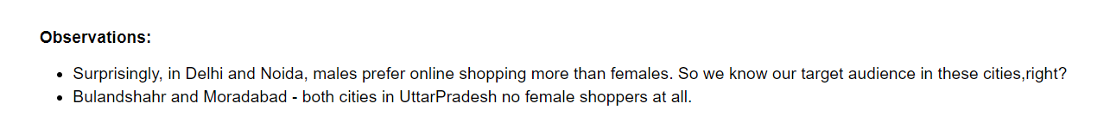

Slide 9
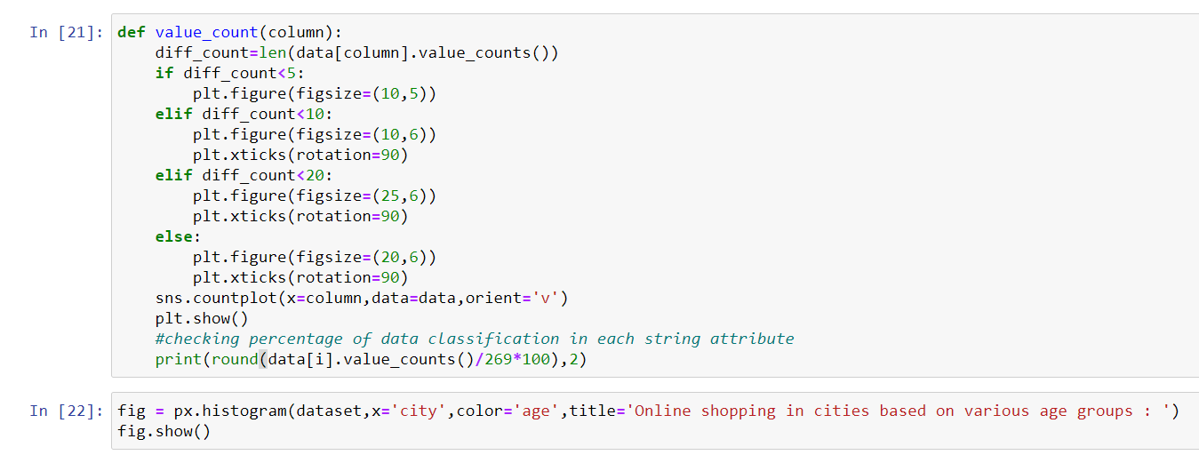
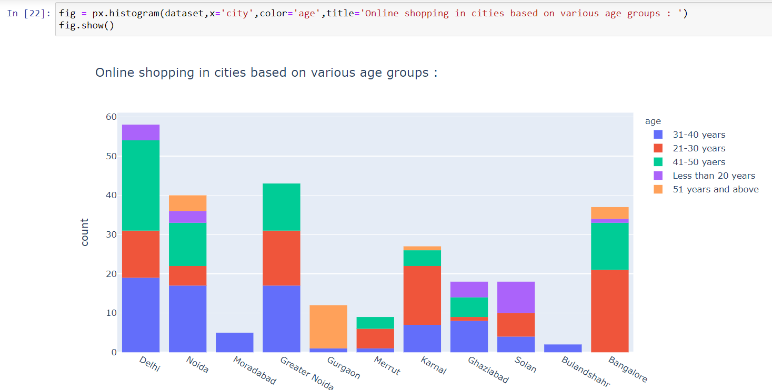
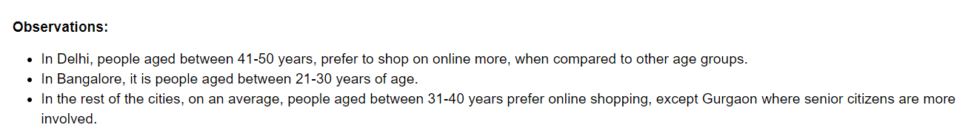

Slide 10
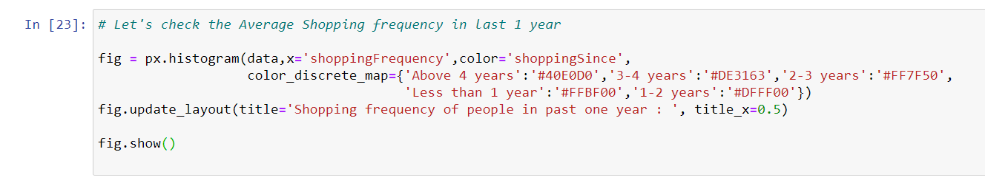
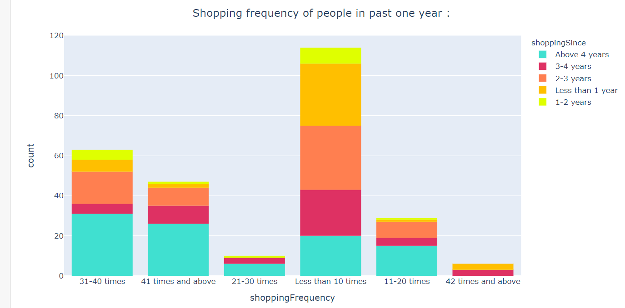
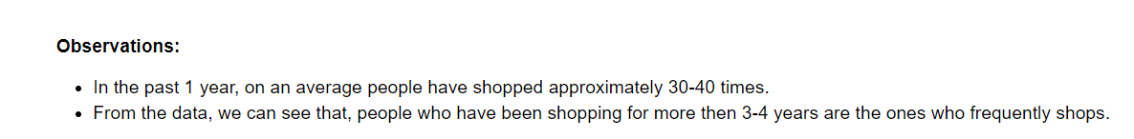

Slide 11
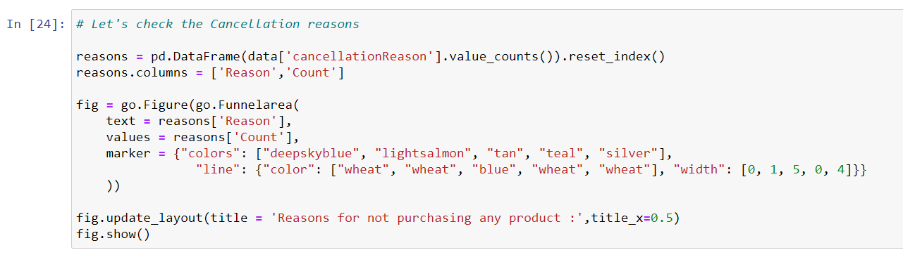
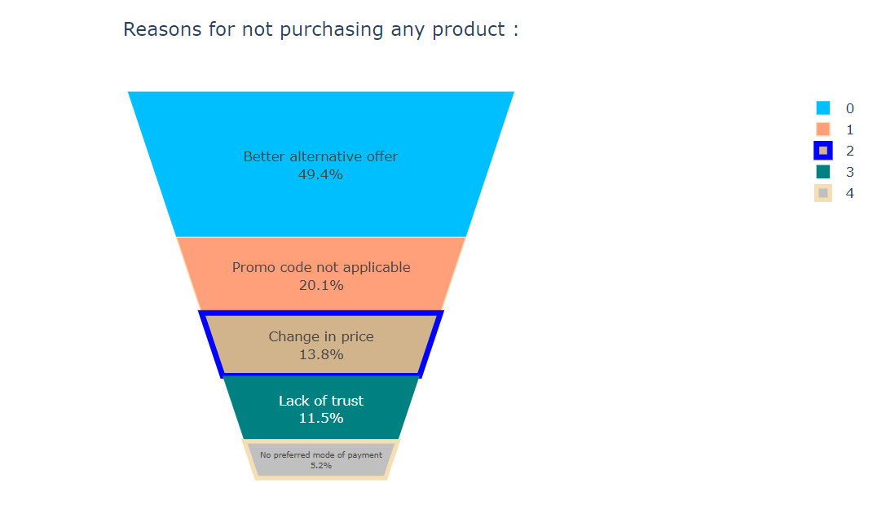
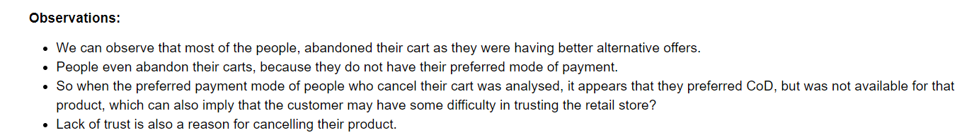

Slide 12
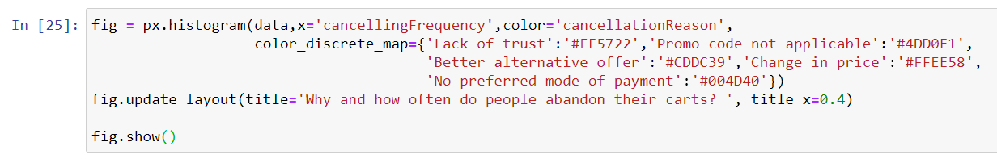
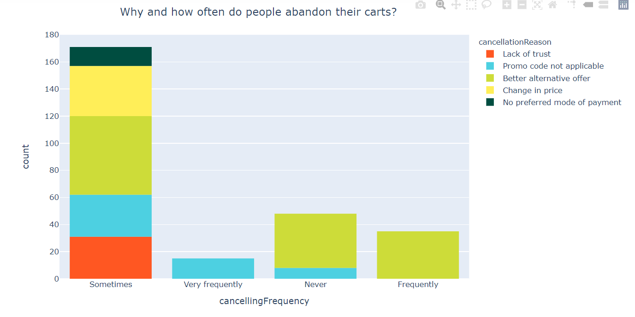
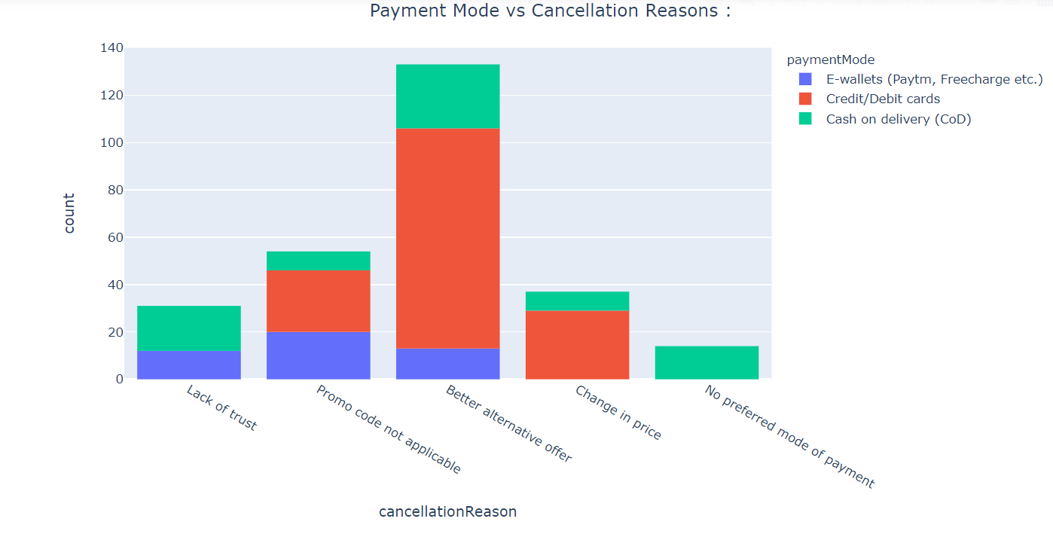
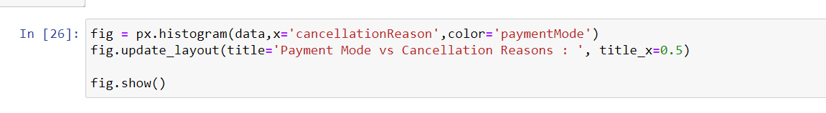

Slide 13
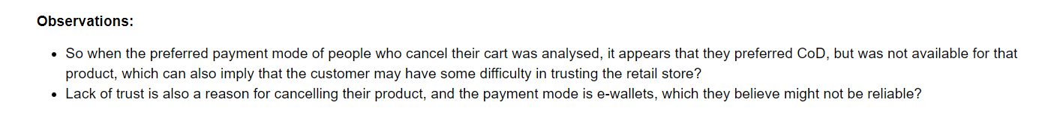
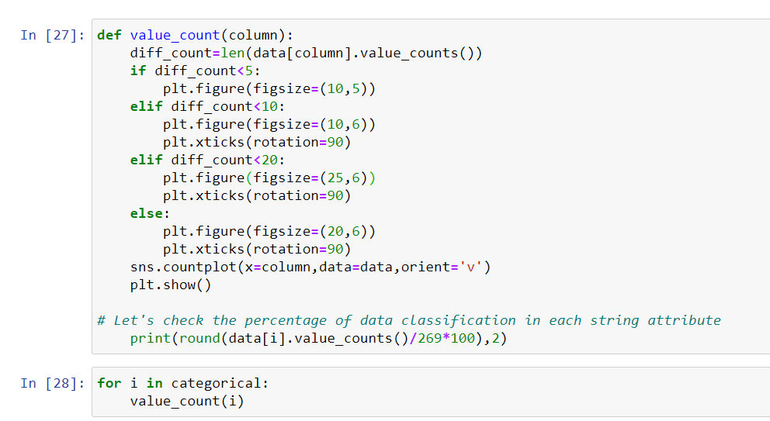

Slide 14
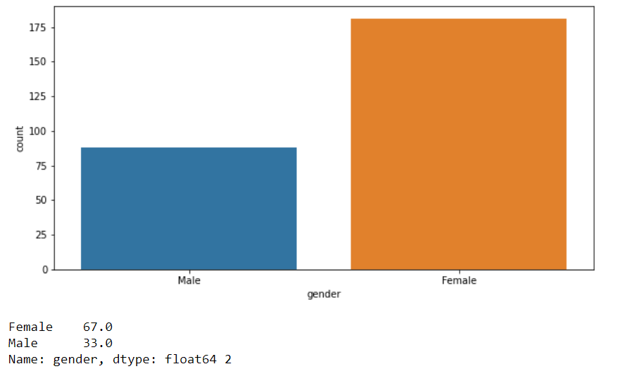
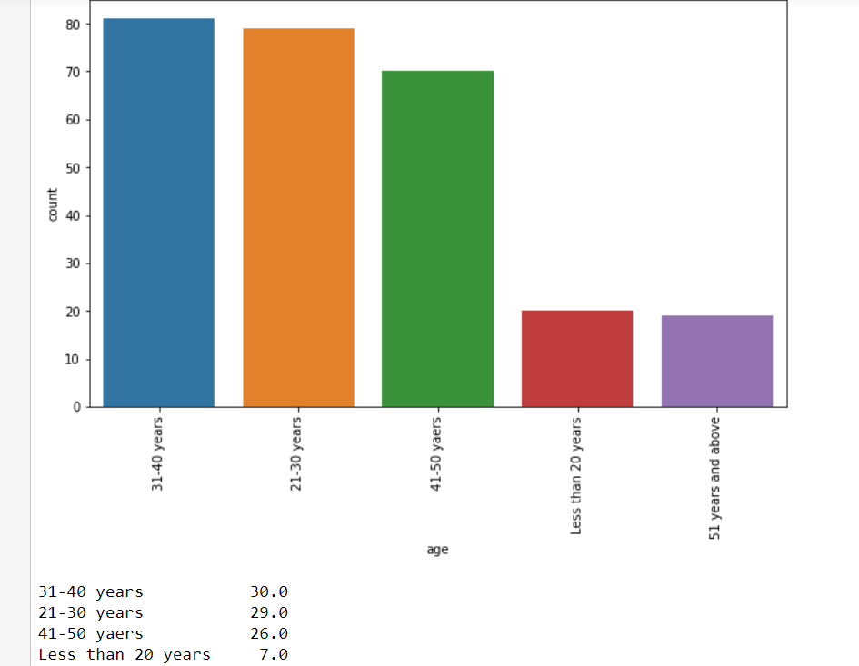

Slide 15
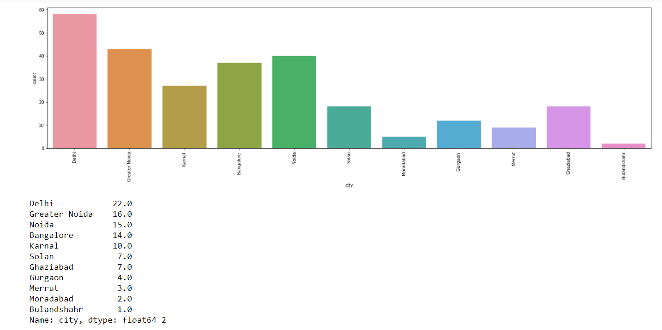
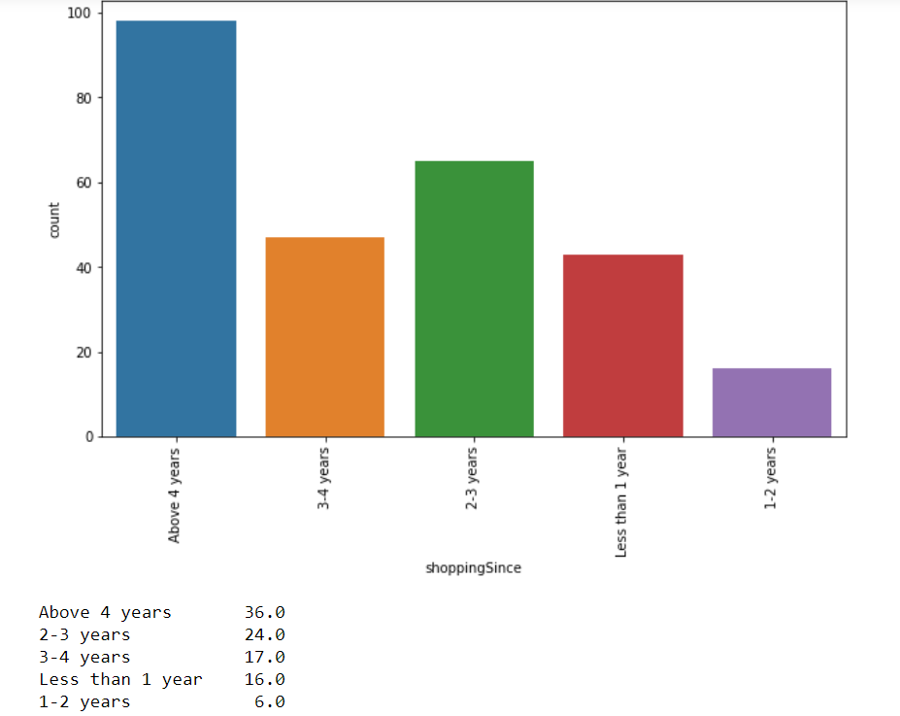

Slide 16
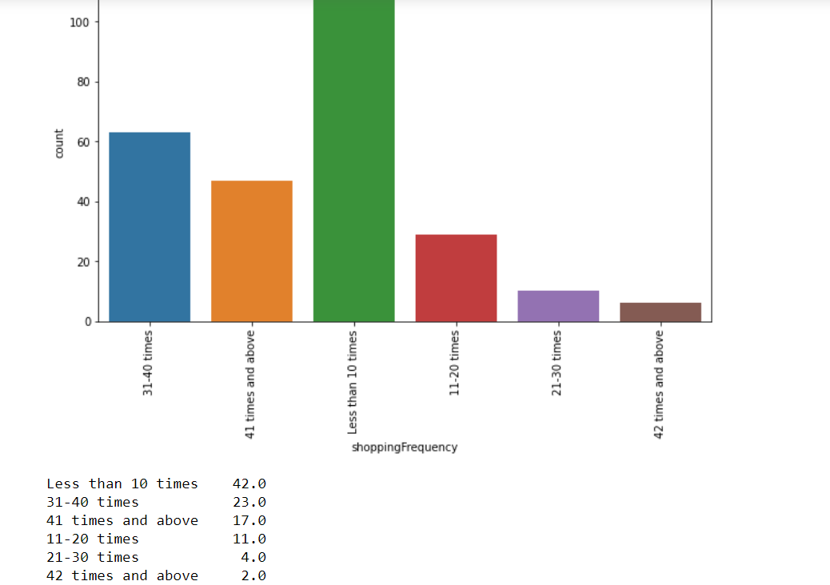
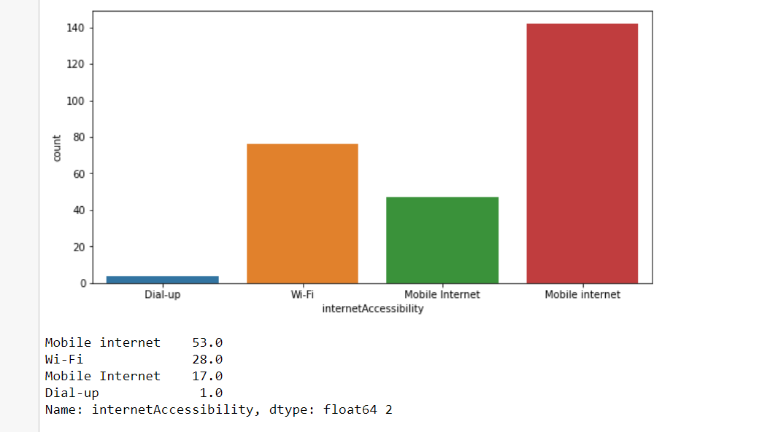

Slide 17
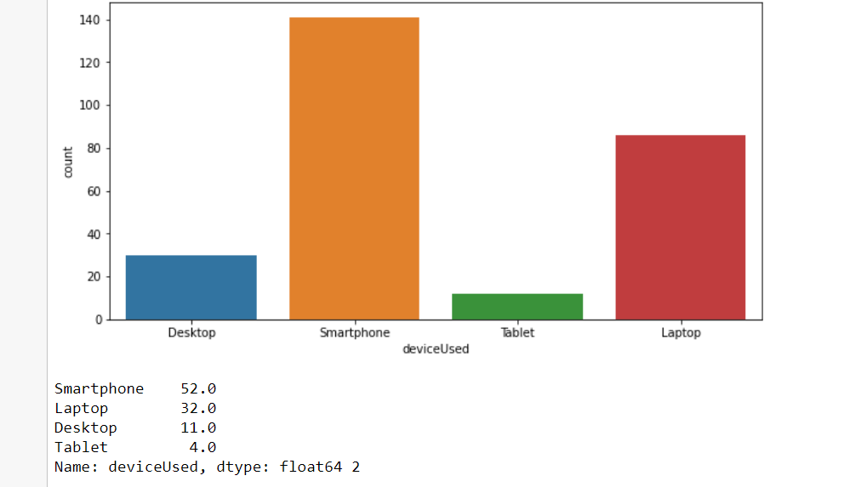
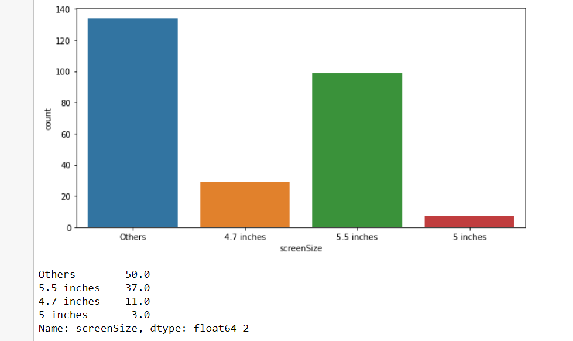

Slide 18
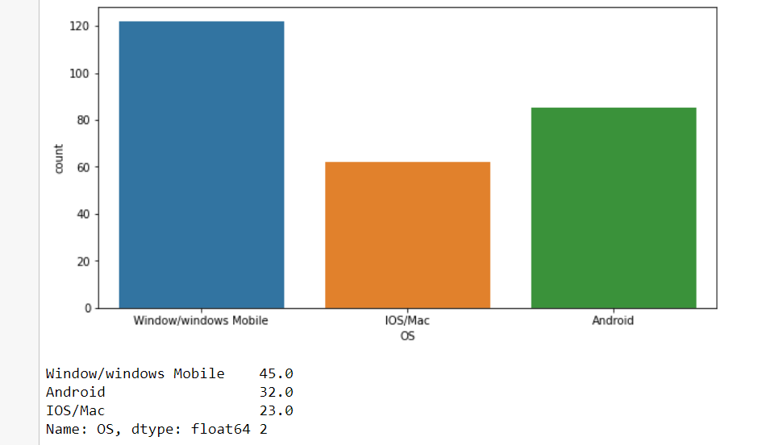
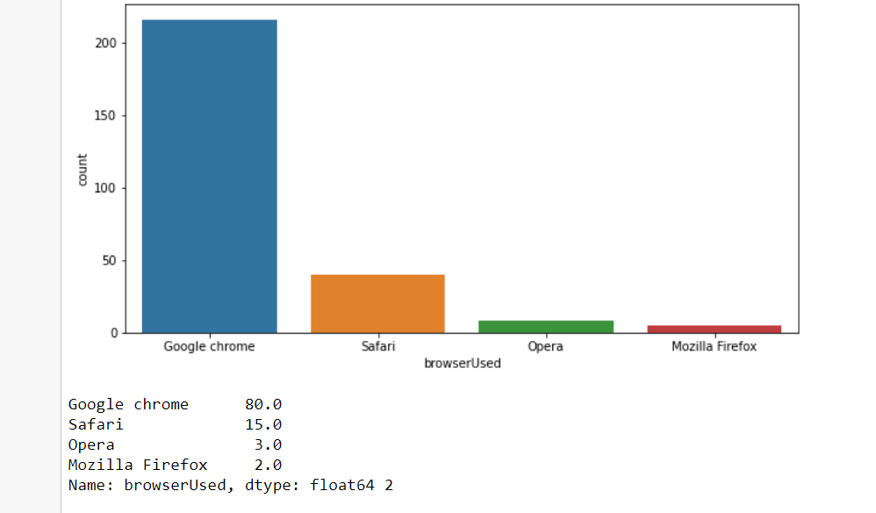

Slide 19
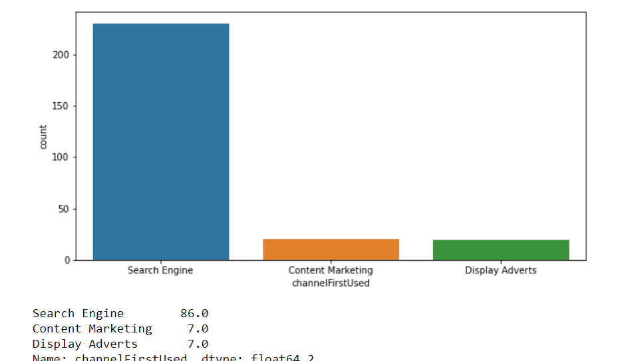
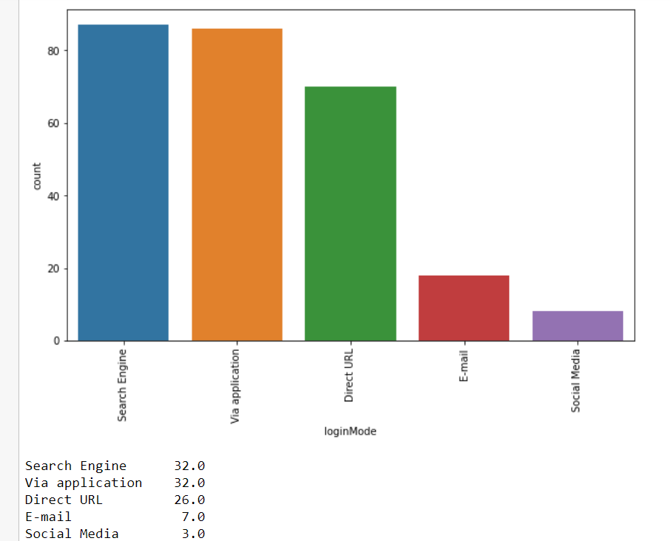

Slide 20
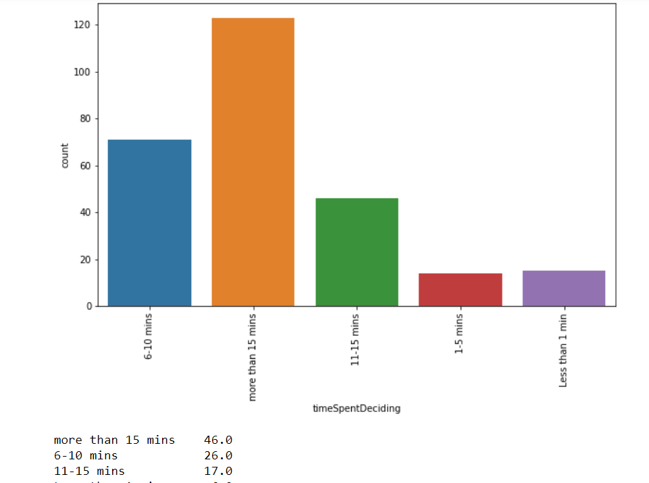
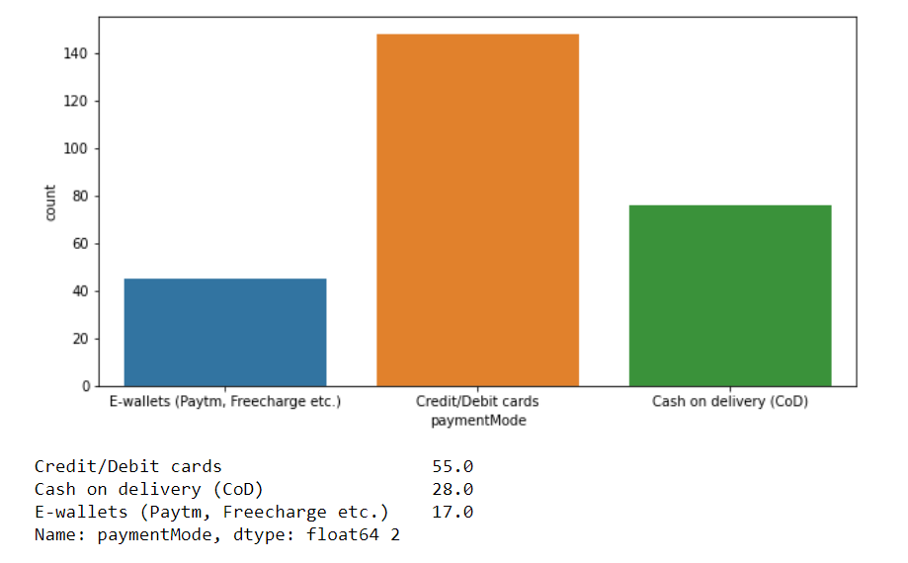

Slide 21
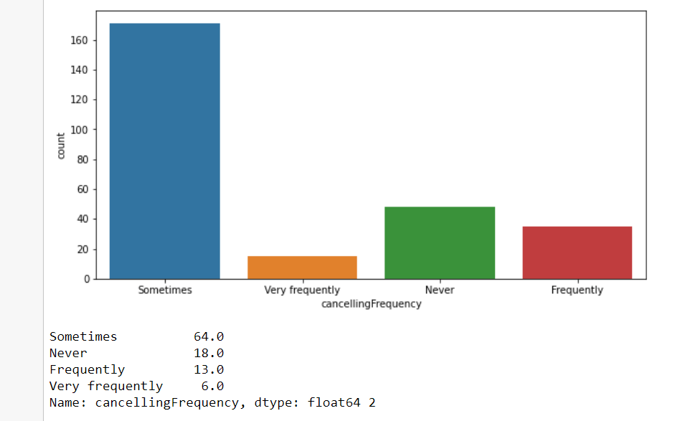
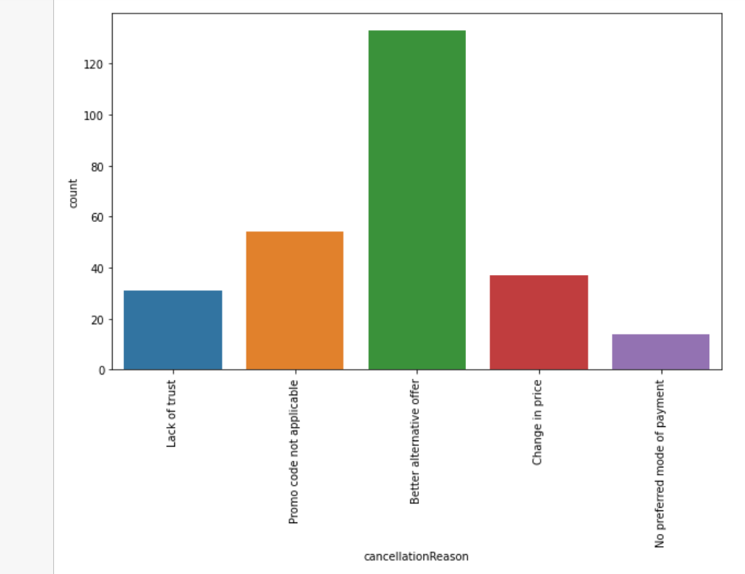

Slide 22
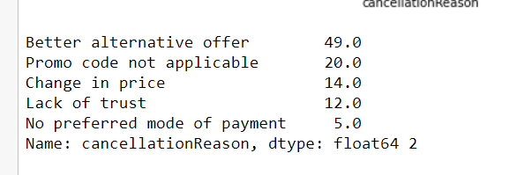
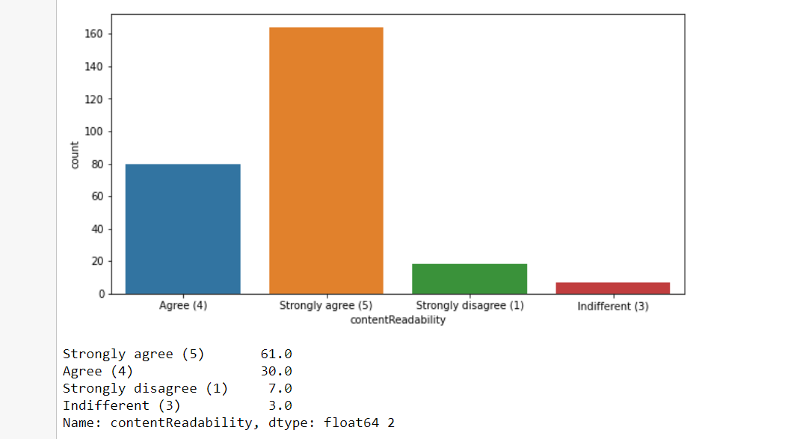

Slide 23
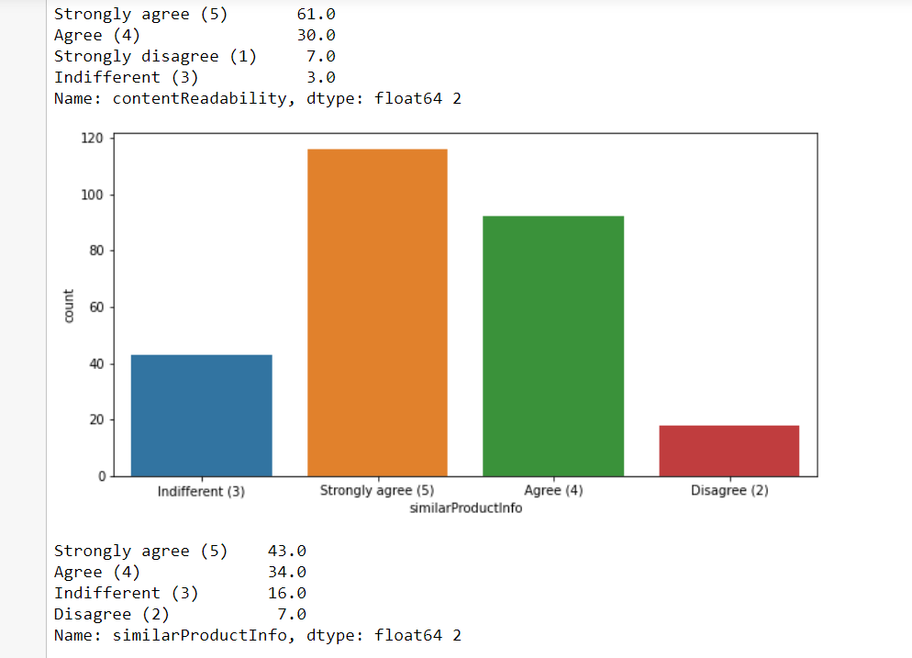
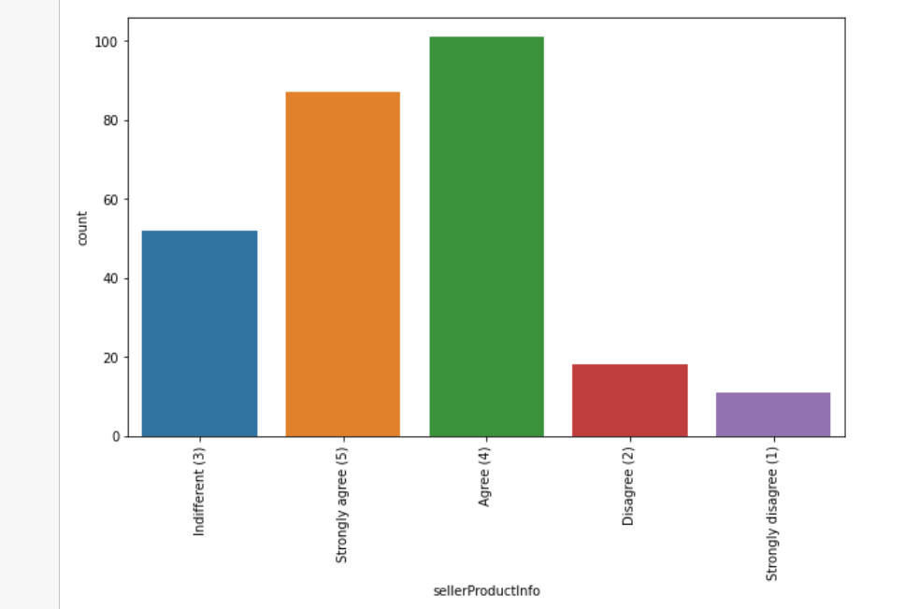

Slide 24
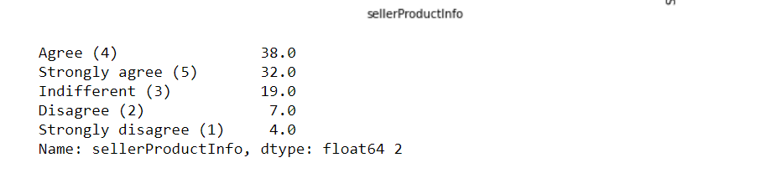
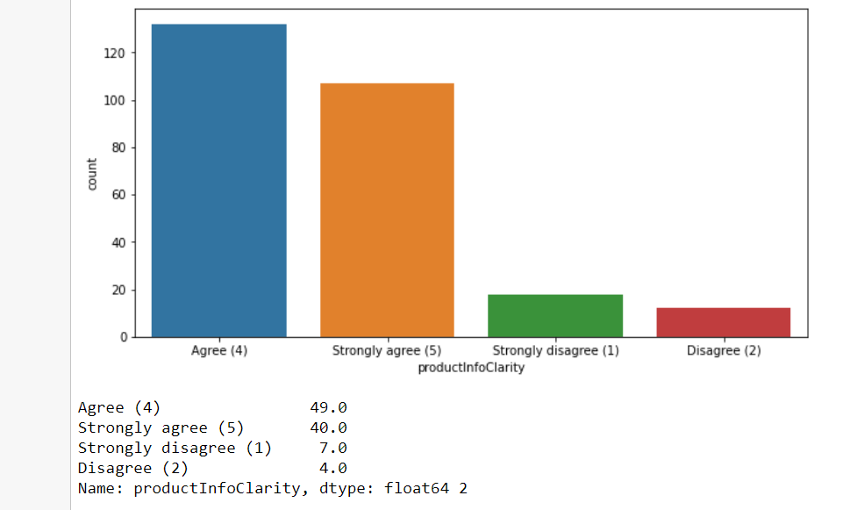
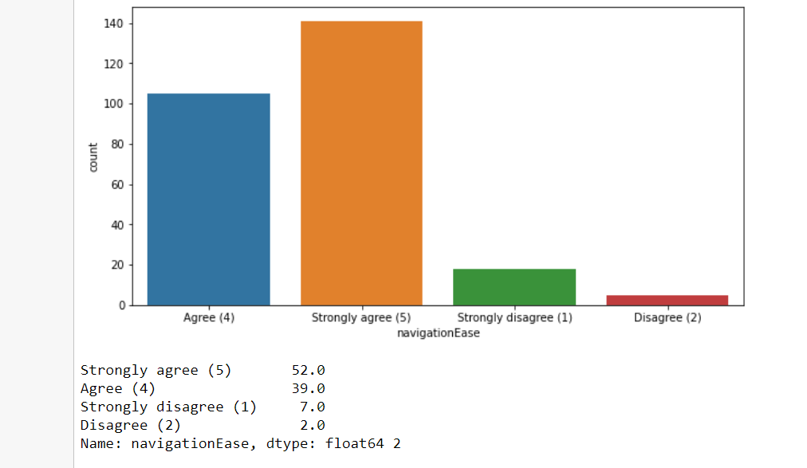

Slide 25
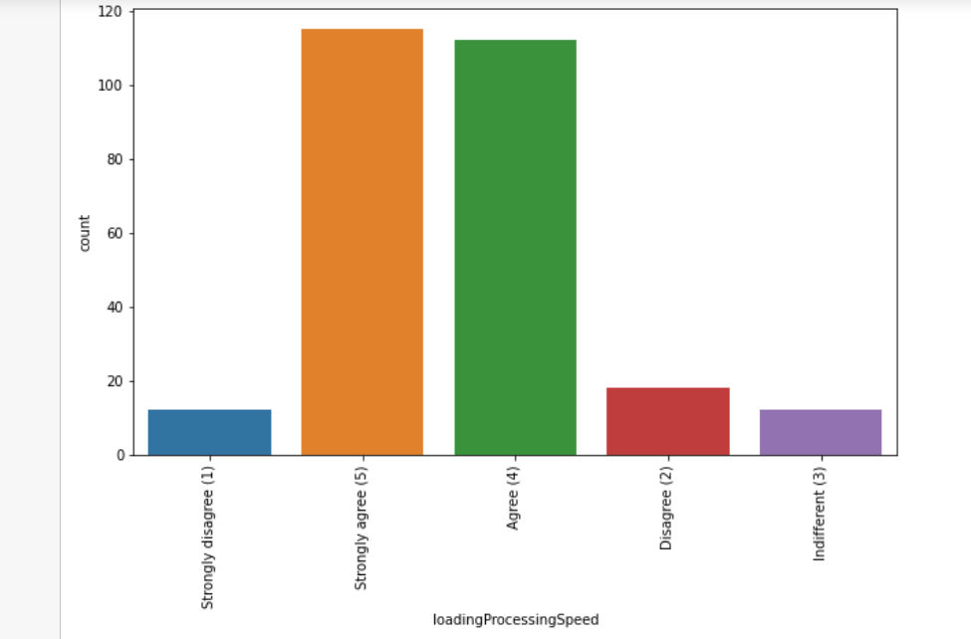
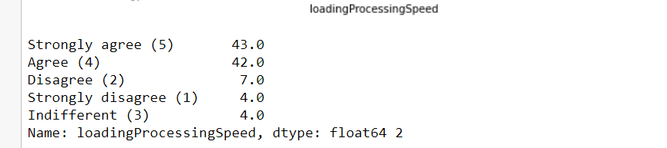

Slide 26



Slide 27



Slide 28




Slide 29



Slide 30



Slide 31




Slide 32



Slide 33



Slide 34



Slide 35



Slide 36



Slide 37



Slide 38



Slide 39



Slide 40



Slide 41



Slide 42



Slide 43



Slide 44



Slide 45



Slide 46



Slide 47



Slide 48



Slide 49



Slide 50



Slide 51



Slide 52



Slide 53



Slide 54



Slide 55



Slide 56



Slide 57



Slide 58



Slide 59



Slide 60



Slide 61



Slide 62
Observations
Female customers (67%) are more than male customers
Customers between 20 to 50 years shopped more from the online store. 75 % of customers are between 20 to 50
Delhi, Bangalore, Noida are the cities with high number of buyers
36% customers were found shopping online for more than 4 years , 24% were shopping for 2-3 years
IN last one year 42% customers have purchased online less than 10 times,23% customers purchased 31-40 times only 2 percent customers purchased more than 42 times
70% customers used mobile internet for online purchase
52% customers used Smartphone for online purchase, 32% used laptop least 4% used tablet
45% customers use Windows phone
80% customers used Google chrome for online purchase

Slide 63
Observations
86% customers uses Search engine to reach their favorite online store
After first visit 32 % customers used search engine to reach online store and 32% uses application. We can assume that these customers have been retained by the E commerce website as they have downloaded the application on their phone and have a fair chance of shopping again. Also, there are a few customers who are using Desktop/Laptop, for which, there are no applications for online shopping and you have to stick with the web browser.
46% customers take at least 15 minutes before making a purchase, 26% take 6-10 minutes only
55% customers prefer Credit/Debit cards to make payments ,28% preferred COD and 17 % preferred Wallets
64% customers abandon their shopping cart sometimes, 19% abandon their cart frequently

Slide 64
Observations
49% customers abandon their bag due to better alternative offer, 20% abandon due to promo code not applicable
61% customers have strongly agreed to have easy website content which is easy to understand 43% customers agree that Information on similar product to the one highlighted is important for product comparison.
70% customers agree that Complete information on listed seller and product being offered is important for purchase decision 90% customers agree all relevant information on listed products must be stated clearly.
90% customers agreed that the website should be easily navigable

Slide 65
Observations
85% customers had no issues with the loading and processing speed
87% customers agree with user friendly website interface. The online stores should invest heavily in creating user friendly apps and websites, so that the customers do not have to work around much and the overall shopping experience is smooth.
59% customers strongly agree with the convenient paying methods. The reluctance to make online payments is gradually reducing. The acceptance has been built by addressing the trust issue over time by giving customers an option to pay online or to pay Cash On Delivery (COD).
52% customers trust that online store will fulfill its part of transaction at stipulated time

Slide 66
Observations
85% customers like the organization's readiness to assist with queries
Being able to guarantee the privacy of the customer: This also got 69% strongly agree. Costumers are concerned about the unauthorized access to their data. Protecting user privacy will enable stores to drive more revenue and gain more customers
Responsiveness, availability of several communication channels (email, online rep, twitter, phone etc.): 90% customers agreed to it. In case one channel is not available, customers can reach out to multiple channels which again is an important factor. Being able to communicate easily can make the difference in both their shopping experience as well as fulfill business goals of online store.
50% agree that online shopping gives monetary benefit and discounts to the customer: Most online shopping sites offer amazing round-the-year discounts. Banks and Digital Wallets have happily jumped on the online shopping bandwagon by providing Reward Points, and instant Cashback offers in addition to brand discounts, which will help to gain new customers

Slide 67
Observations
60% customers enjoys online shopping
84% customers agree that online shopping is convenient and flexible:
90% customers agree that return and replacement policy helps them making purchase decision. It is evident from the fact that people cannot actually try & touch the products, they are purchasing before it reaches home and they would want to return or replace in case of dissatisfaction. Online shopping websites should make strategies around easy return and replacement policy if they want to retain their customers.
Around 50% customers agree that gaining access to loyalty program is a benefit of shopping online

Slide 68
Observations
Displaying quality Information on the website improves satisfaction of customers: 80% customer agreed to it. It means displaying quality information have a significant association with customer satisfaction, and repurchase intentions
95% customers are satisfied while shopping on a good quality website
Net Benefit derived from shopping online can lead to users satisfaction:90% customers agreed
User satisfaction cannot exist without trust: 85% customers agree that customer satisfaction cannot be built without trust. Trust is important factor to attract e-commerce buyers. So, it is important for companies to learn how to manage consumers' trust

Slide 69
Observations
Offering a wide variety of listed product in several categories: 75% use agreed.
86% customers like to have complete and relevant information
80% customers agree to receive monetary savings while shopping online
50% agree with the convenience of patronizing the online retailer
50% customers agree that online shopping give the sense of adventure
only 30% customers agree that online shopping enhances their social status
45% customers feel gratified while shopping with their favorite retailer
45% customers feel that shopping online helps them fulfill certain roles
85% customers agree they get value for their money while shopping online

Slide 70
Observations
Observations from Multiple Options based Questions i.e. related to company name specific parameters, after 47th rows
Maximum people have shopped from these 5 companies - Amazon.in, Flipkart.com, Paytm.com, Myntra.com, and Snapdeal.com.

Slide 71
Observations
48% customers says flipkart, amazon shows wide variety of products
37% customers like flipkart and amazon in terms of displaying complete and relevant information of the products
In terms of speed Amazon.in is liked by 90% customers , 60 % like Flipkart , 27% Myntra
78% customers trust Amazon to be reliable , 55% likes flipkart , 25% Myntra
80% customers likes Amazon's quickness to complete the purchase , 60% likes Flipart's, 30% likes Myntra's
86% likes Amazon's delivery speed , 56% likes Flipkart's , 5% likes Myntra’s 82% customers trust amazon in terms of keeping the privacy of their data, 56% trust flipkart 20% trust Myntra , 12 % trust Snapdeal
70% trust amazon in terms of keeping their financial information secured, 56% Flipakrt, 34% Myntra , 21% Snapdeal , 22@ Paytm

Slide 72
Observations
84% customers believe Amazon perceived trustworthiness, 43% - Flipkart , 33% - Myntra ,Snapdeal 27% Snapdeal
86% customers like Amazon in terms of online assistance through multi-channel , 51% -Flipkart ,42% Myntra 50% customers agree that Amazon takes longer time to log them in while in sales period/promotions , 39% goes with flipkart, 13% goes with Myntra , 16% Snapdeal
46% customers says that amazon takes longer time in displaying photos in sales/promotion , 35%- flipkart, 21% Snapdeal, 14% Myntra, 11% Paytm
In terms of late declaration of price in promotion/sales 28% goes with Myntra, 21% amazon , 16% flipkart , 18% Snapdeal, 23% Paytm
In terms of longer page loading in promotion/sales 26% customer goes with Myntra, 23% flipkart, 23% amazon, 24% Snapdeal

Slide 73
Observations
In terms of limited mode of payment on most products during sales period/promotions 41% goes with Snapdeal, 40% -amazon, 23% flipkart, 20% Paytm and only 3% Myntra. Hence Myntra gives most payment options during sales/promotion.
In terms of time taken in product delivery Paytm has highest votes of 37%, Snapdeal 24%, flipkart 16%, amazon 14% and Snapdeal and Myntra 10%. Hence Snapdeal and Myntra take minimum time for delivery among all.
20% customers dislikes disruptions while moving to another page on amazon, 24% on Myntra, 27% Snapdeal, 14% Paytm, 23% Snapdeal 61% customers says that amazon website is as efficient as before, 43% for flipkart, 22% for Paytm, 9% for Snapdeal
81% customers would like to recommend amazon to a friend, 43% would like flipkart , 22% would like for Myntra , 9% for Paytm and least 4 % would like to recommend Snapdeal

Slide 74



Slide 75



Slide 76



Slide 77



Slide 78



Slide 79



Slide 80



Slide 81



Slide 82


Slide 83


Slide 84
Observations
Even though females are dominant in the dataset, female population using ecommerce is not dominant everywhere In Delhi and Noida more numbers of males are using ecommerce than female.
Bulandshahr and Moradabad - both cities in Uttar Pradesh has no female shoppers at all.
Numbers of females who are shopping since long are more than number of males.
Frequency of females shopping online is more than males
Most of the females usually take more than 15 meanwhile most of the male spend 6-10 min before making a purchase decision.
More females strongly agree with the fact that there must be similar products to compare. Males do agree with the fact but the data suggests that it is okay if there exists a product but also okay if there does not exist one.

Slide 85



Slide 86



Slide 87




Slide 88



Slide 89



Slide 90



Slide 91



Slide 92



Slide 93



Slide 94



Slide 95



Slide 96



Slide 97



Slide 98



Slide 99



Slide 100



Slide 101



Slide 102



Slide 103



Slide 104



Slide 105



Slide 106



Slide 107



Slide 108



Slide 109
Observations
Females have shopped more number of times in last 1 year
Most of the individuals that do online shopping are from the age group 21-30 yrs. and, 31-40 yrs. People below 20 years, &people over 50 years of age do not do much online shopping.
Customers from Delhi, Noida & Bangalore region have shopped most number of times
Most customers who are shopping online from 1 to 4 years have shopped less than 10 times and customers shopping online for above 4 years have highest purchase count in all more than 10 times group
Most customers spends more than 15 minutes before making decision irrespective of the purchase count.
Most of the customers generally preferred credit/Debit cards for payment followed by cash on delivery. Very few customers opt for E-wallet payment.

Slide 110
Observations
Most customers who purchased less than 10 times abandoned the cart due to better alternative offer. Customers purchasing more than 41 times abandoned due to promo code not applied Or better alternative offer
It can be seen clearly that all customers irrespective of the purchase count strongly agree with the empathy which means empathy is very important for customer satisfaction and hence retention. The reason is insecurity amongst the customers. If they have a provision of a helpline number associated with the website, that sense of insecurity vanishes and the customer can trust the website more. A 24X7 support is a must for these online retail stores.

Slide 111
Observations
We can clearly see that return and replacement policy plays an important role in customer satisfaction.
Displaying quality Information on the website improves satisfaction of customers: Most of the customers strongly agreed to this. Shoppers expect online retailers to provide all relevant and accurate information about the product. Providing appropriate information can help online retailers to dispel concerns and fears of consumers towards a particular product or online shopping
Maximum customers agree with online shopping being flexible, irrespective of purchase count as it provides freedom to shop without the influence or pressure from sales staff often encountered in offline stores.

Slide 112
Observations
User satisfaction cannot exist without trust: We see that, user with lack of trust have shopped less number of time. It means, trust is an area where online shopping still lags as several instances have been reported of customers being duped on receiving products that did not match the description claimed or turned out to be knock-offs. So, it is important for companies to learn how to manage consumers' trust
Customers who have shopped more than 30 times strongly agree that net benefit from online purchase leads to user satisfaction Hence net benefit derived is an important factor for customer retention
Offering a wide variety of listed product in several categories: Customers having purchase frequency of more than 30 times strongly agree to it. It means product variety increases consumers' likelihood of finding a good match with their preferences

Slide 113
Observations
Customers with high purchase (>30) agree to get monetary savings
Almost all customers with high purchase agree that they get value for money spent.it indicates that quality of product sold plays an important role in customer retention
Highest number of customers have shopped from amazon, Paytm and Myntra
Highest number of customers like amazon, Paytm and Myntra web page layout
Highest number of customers like amazon and flipkart in terms of variety of product offered
Highest number of customers like amazon and flipkart in terms of relevant and complete description of products

Slide 114
Observations
High proportion of high purchase frequency customers like amazon and Paytm in terms of website speed
Highest reliability is obtained by amazon and flipkart
Highest number of customers like Amazon in terms of quickness to complete purchase
In terms of payment option Amazon, Flipkart and Myntra are liked most by the high purchase frequency customers
Amazon stands apart in terms of speed of order delivery and privacy of customers information
Most of customers like amazon in terms of online assistance through multichannel
Most user claims flipkart to take maximum login time during sales/promotion
Highest customers claims Myntra take maximum time in displaying graphics and photos

Slide 115
Conclusion
Customer retention doesn't improve overnight. Customer retention is fickle when customer service is lacking. Few ways to improve customer retention can be as follows:
Easily navigable : 90% customers agreed that the website should be easily navigable. Website navigation is a key to the success of any e-commerce website. It should be clean, clear and user-friendly. Online store should create easy-to-use navigation on website to make sure that, customers don’t get confused while surfing the site.
User-friendly websites: 87% customers agree with user friendly website interface. The online stores should invest heavily in creating user friendly apps and websites, so that the customers do not have to work around much and the overall shopping experience is smooth,& shoppers get what they want faster and without running into unnecessary complexity that can clog up the path to purchase. It should focus on the user experience by providing shopping categories, filters, and comparison capabilities. User-friendliness requires that your website works on all browsers and devices

Slide 116
Conclusion
Privacy Policy: Being able to guarantee the privacy of the customer:92% Customer agreed to this. Costumers are concerned about the unauthorized access to their data. Building trust with the customers is crucial for any e-commerce website. An e-commerce privacy policy statement makes business more transparent regarding how you collect, manage, and use data from site visitors.
• Displaying quality Information on the website: 90% customers agree all relevant information on listed products must be stated clearly. Content is one of the crucial challenges for any e-commerce website. it’s simply not enough to just list a product name and image on a product page and expect the orders to roll in. Compiling a compelling array of product data, whether that’s dimensions, MPNs or spec sheets can all help to convert customers better.

Slide 117
Conclusion
Responsiveness, availability of several communication channels (email, online rep, twitter, phone etc.): 90% customers agreed to it. In case one channel is not available, customers can reach out to multiple channels which again is an important factor. Being able to communicate easily can make the difference in both their shopping experience as well as fulfill business goals of online store.
When customers are satisfied with a company or service, there is a high possibility that they will share their experience with other people Therefore it is crucial for E-commerce to take into account their customer satisfaction because this will retain customer loyalty as well as attract potential customers.

